Slide 1
AIM6140: Health Informatics
Health Data - types and Data Sources

Slide 2
Health data and their importance
Data is key to healthcare technology development, creating better treatments, and improving patient care.
Every health decision you’ve ever heard about – from vaccine rollouts to hospital funding – starts with data. When governments decide where to build new hospitals or how to tackle rising diabetes rates, they’re not making educated guesses. They’re using carefully collected information from various sources to paint a clear picture of public health needs.

Slide 3
Primary vs Secondary health data
Primary data sources involve collecting information directly from the source for a specific purpose. These are like conducting your own survey or interview – you’re gathering fresh information that hasn’t been processed or interpreted by others.
Examples of primary data sources in healthcare include clinical trials where researchers directly observe patients taking new medications, community health surveys where teams go door-to-door collecting health information, and hospital records where medical staff document patient symptoms and treatments in real-time.
Advantages and limitations:
  Primary data sources offer high accuracy and relevance since the information is collected specifically for your research question. However, they’re often expensive, time-consuming, and may have limited scope due to resource constraints.

Slide 4
Primary vs Secondary health data
Previously collected information: Secondary data sources use information that was originally collected for other purposes. It’s like using existing research papers, government reports, or hospital databases to answer new questions.
Examples of common secondary data sources include national health surveys conducted by government agencies, medical literature and research publications, insurance claim databases, and vital registration systems that record births, deaths, and causes of death.
Advantages and limitations:
  Secondary data sources are typically more cost-effective and allow for larger sample sizes and longer time periods. However, the data might not perfectly match your research needs, and you have less control over data quality and collection methods.

Slide 5
Key agencies which collect health data
National agencies
Ministry of Health and Family Welfare
National Sample Survey Organization (NSSO)
Registrar General of India
National Family Health Survey (NFHS)
International agencies
World Health Organization (WHO)
UNICEF
World Bank
United Nations Population Division

Slide 6
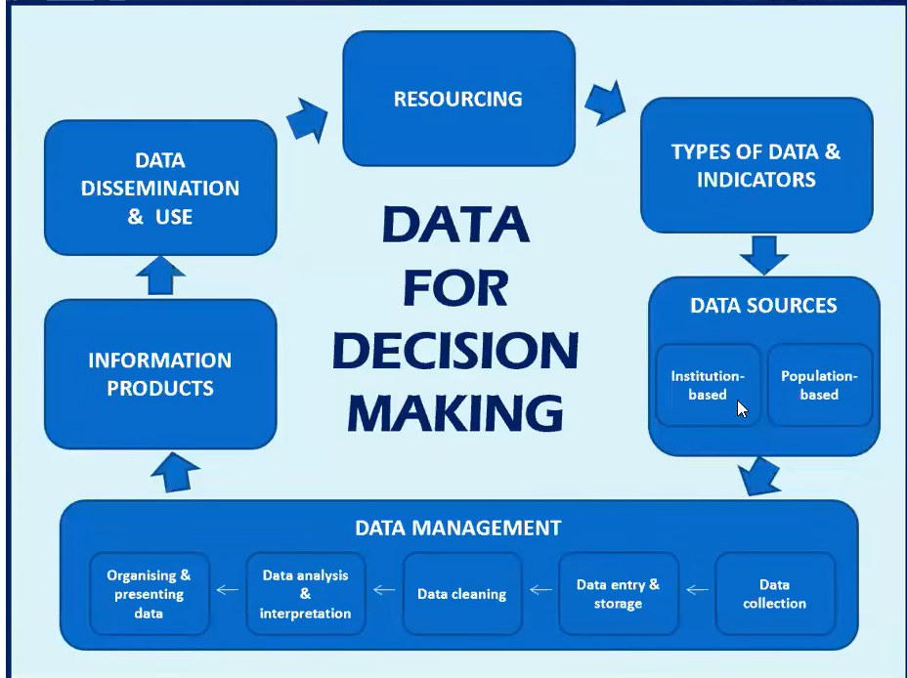
The data for decision making

Slide 7
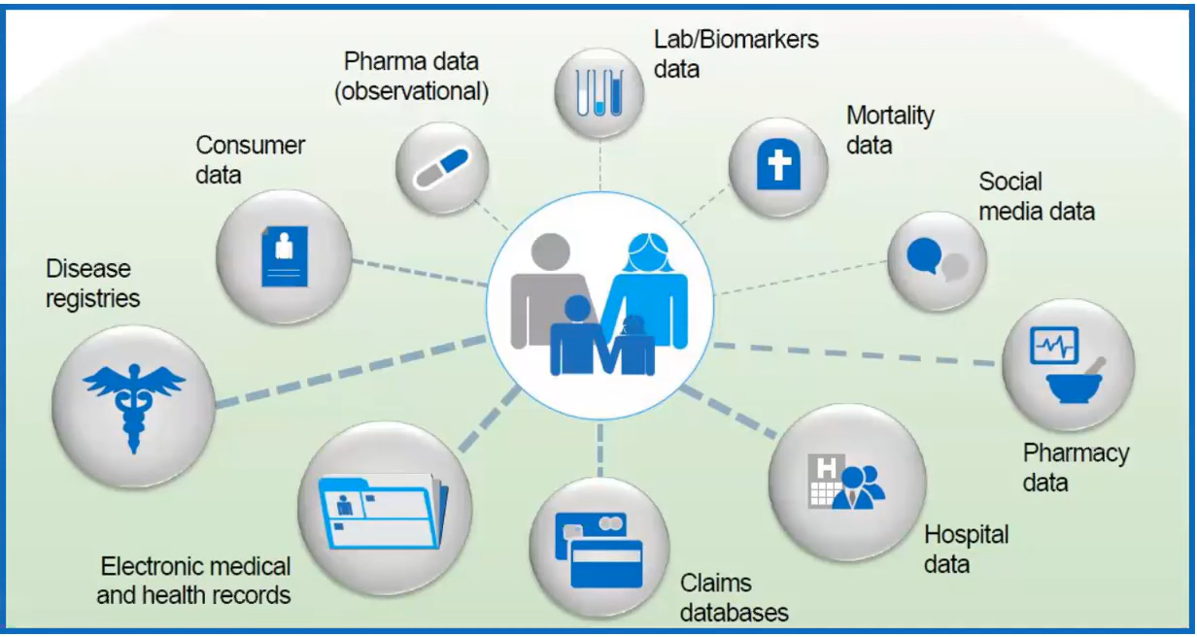
Sources of health data

Slide 8
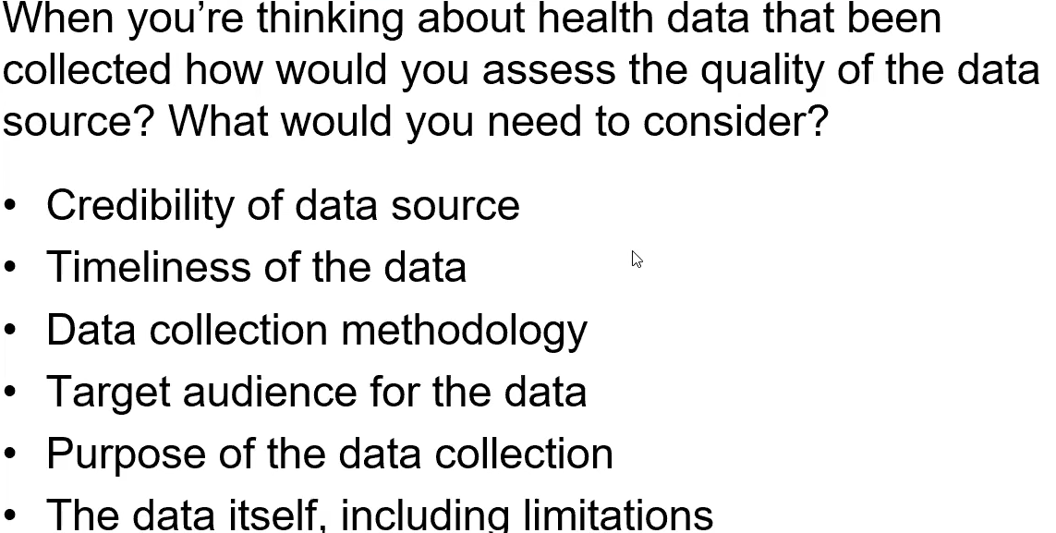
Assessing health data

Slide 9
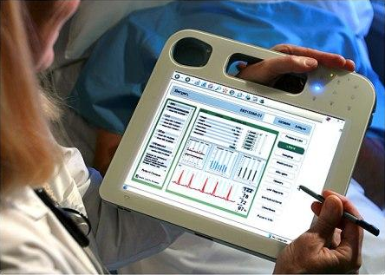
Electronic health records
An electronic health record is a repository of information about a single person in a medical setting, including clinical, demographic and other data.
The repository resides in a system specifically designed to support users by
  providing accessibility to complete and accurate data
  may include services to provide alerts, reminders, links to medical knowledge and other aids to clinical practice.

Slide 10
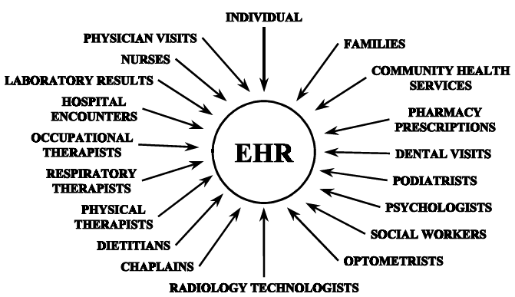
Sources for EHRs

Slide 11
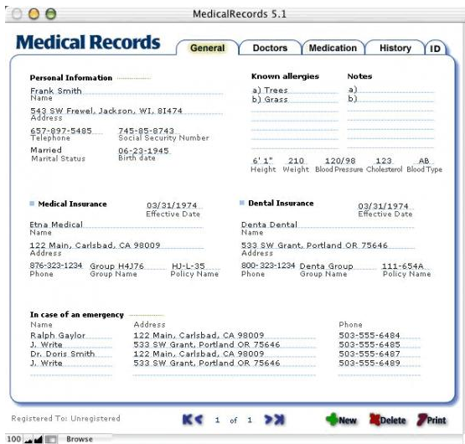

Slide 12
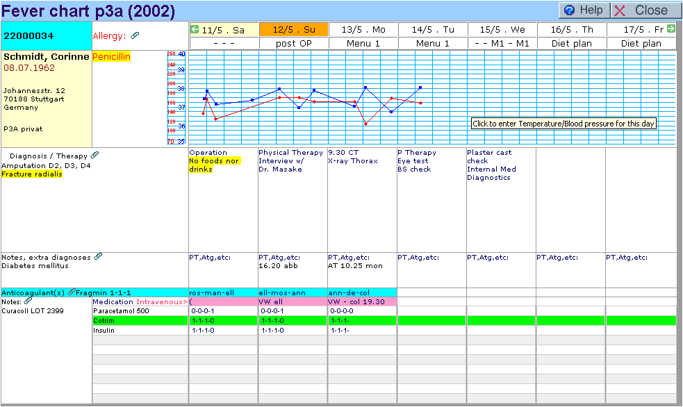
The electronic medical record

Slide 13
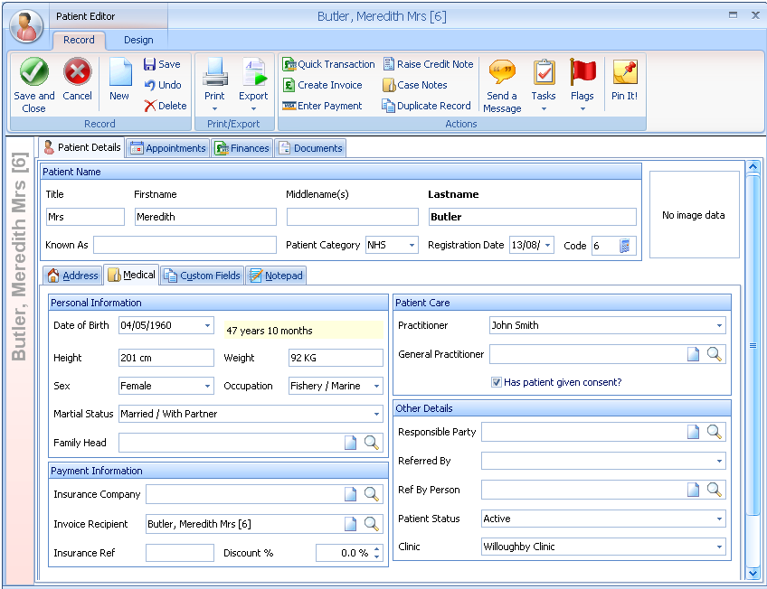
Examples

Slide 14
Goals of Using the EHR
Provide a single, uniform medical record.
Ability to access medical records from any location.
Improve documentation and coding.
Improve research / clinical trials data / enhance quality.
Reduce transcription and other rising costs.

Slide 15
Functions of the EHR (1)
Supports structured data collection using a defined vocabulary.
Accessible at any or all times by authorized individuals.
Contains a problem list - patient’s clinical problems and current status
Supports systematic measurement and recording of data to promote precise and routine assessment of the outcomes of patient care
States the logical basis for all diagnoses or conclusions as a means of documenting the clinical rationale for decisions about the management of the patient’s care.

Slide 16
Functions of the EHR (2)
Can be linked with other clinical records of a patient—from various settings and time periods—to provide a longitudinal (i.e. lifelong) record of events that may have influenced a person’s health.
Can assist the process of clinical problem solving by providing clinicians with decision analysis tools, clinical reminders, prognostic risk assessment and other clinical aids.
Can be linked to both local and remote databases of knowledge, literature and bibliography or administrative databases and systems so that such information is readily available to assist practitioners in decision making.
Addresses patient data confidentiality.
Can help practitioners and health care institutions manage the quality and costs of care.

Slide 17
Electronic health records: pros
Compact
Concurrent use
Easily copied/archived
Portable (handheld and wireless devices)
Secure
Supports many other services
  Decision support
  Workflow management
  Performance audits
  Research

Slide 18
Electronic health records: cons
High capital investment
  Hardware, software, operational costs
  Transition from paper to computer
Training requirements
Continuing security debate
  Stealing one paper record is easy, 20 is harder, 10,000 effectively impossible – the security risks are very different for electronic data.
  Power outs – the whole system goes down!

Slide 19
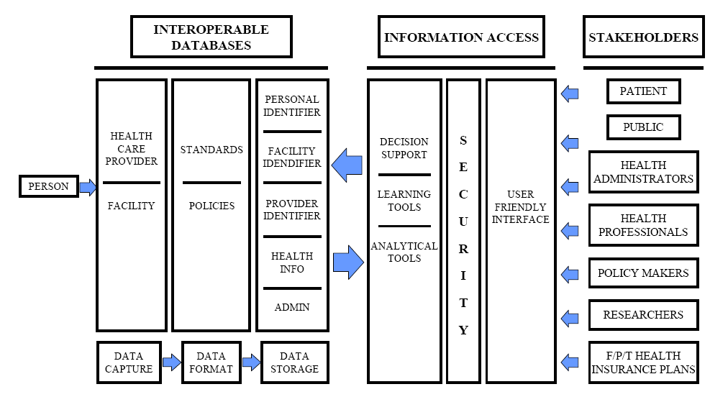
User view

Slide 20
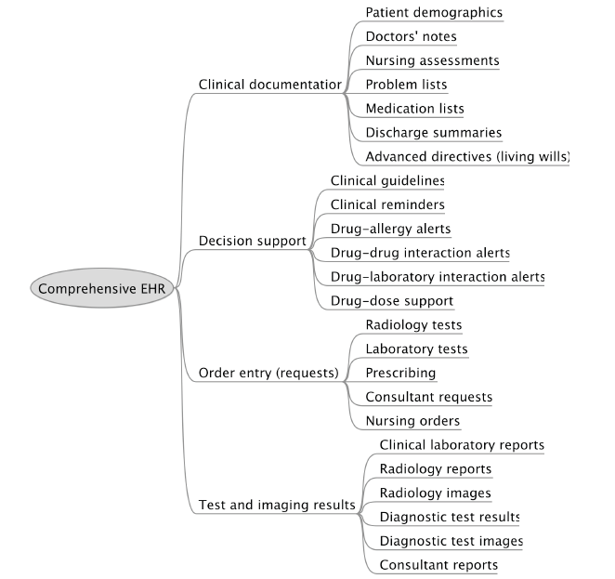
Functional view

